Slide 1
Tmp006 Temperature sensor
Jerreh Janneh

Slide 2
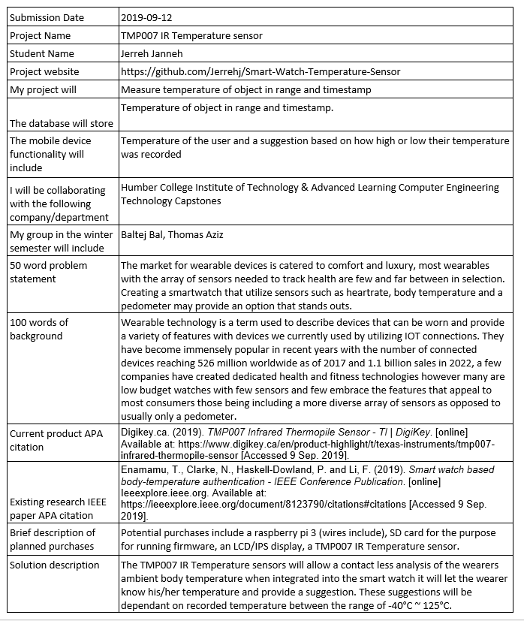
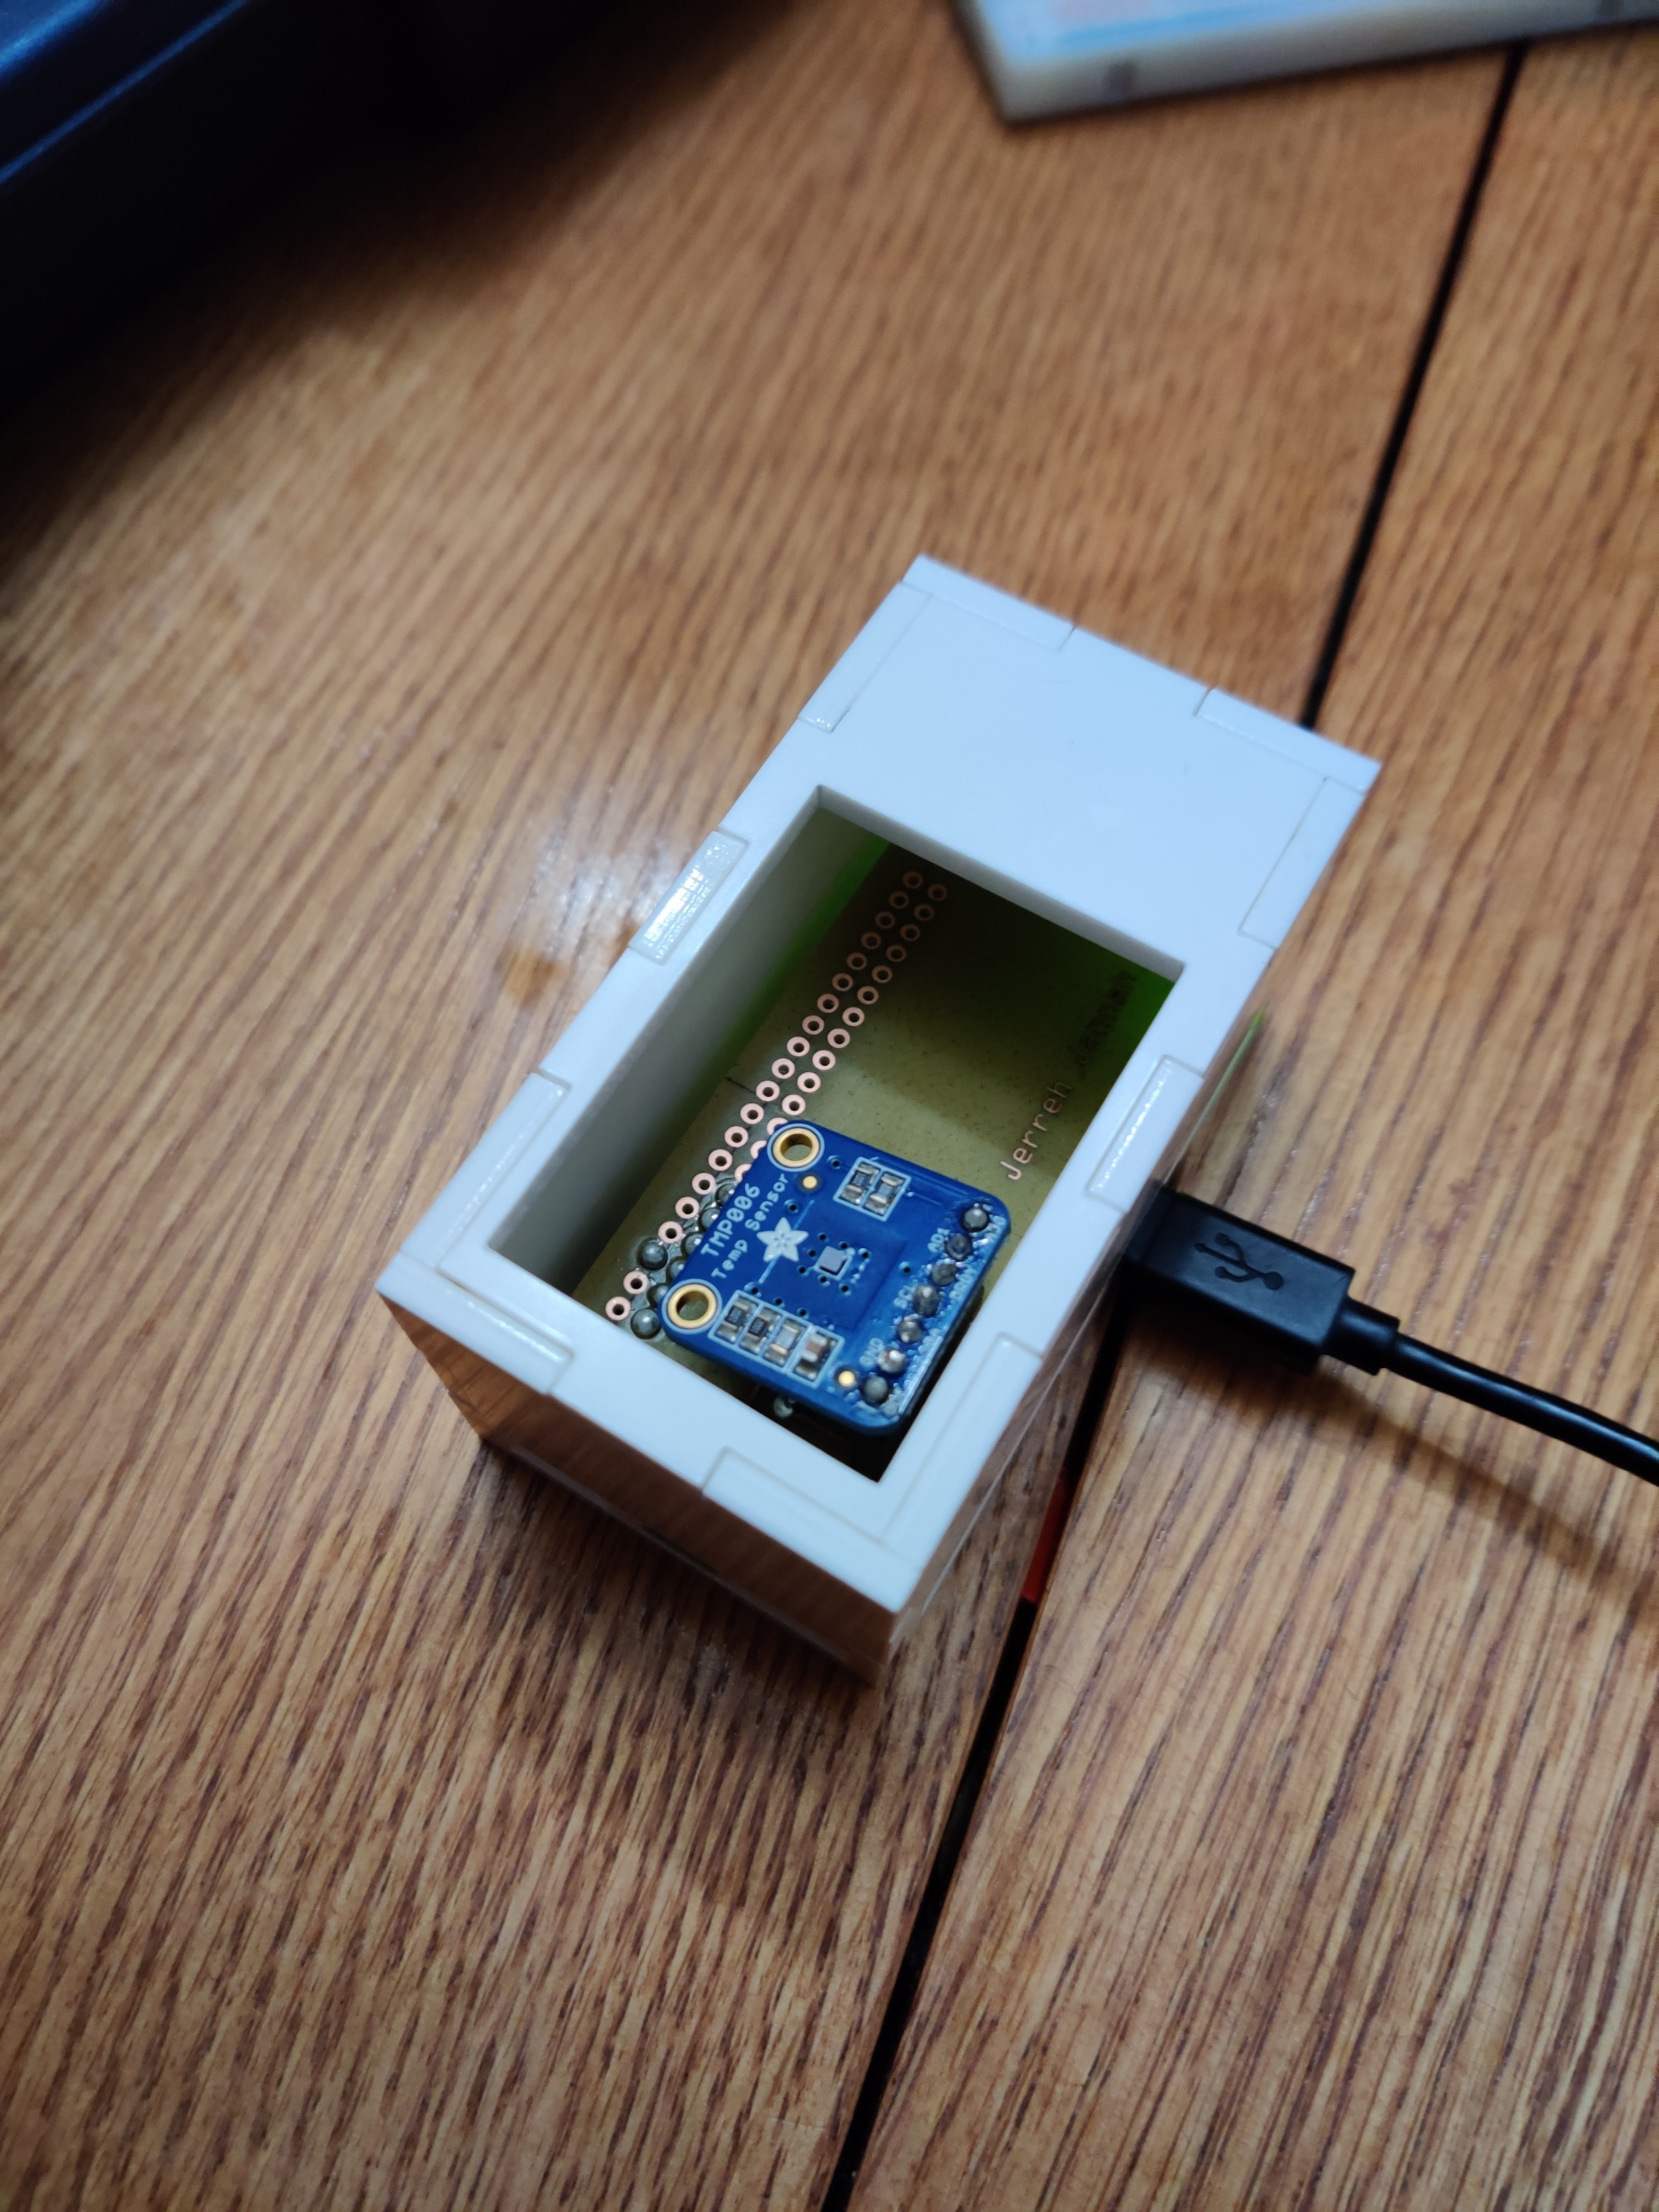
Proposal
Sensor intended to be implemented into a wearable device
Detects heat using an IR beam
Lets user know about their body temperature
Ideal use: fitness tracking

Slide 3
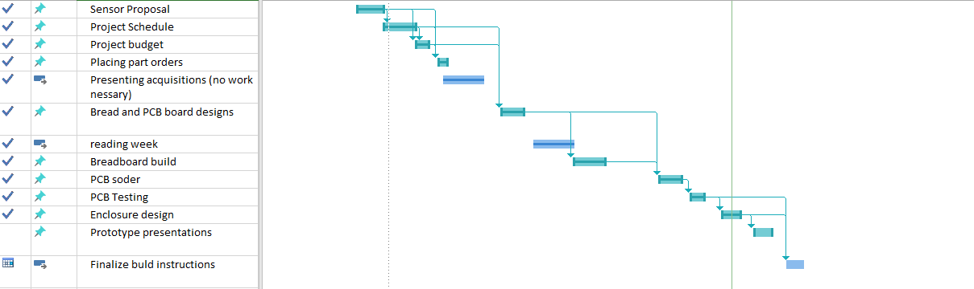
Schedule
Milestones set at 14 weeks
Most milestones were reached on time
Extra commitment needed for PCB revisions and testing

Slide 4
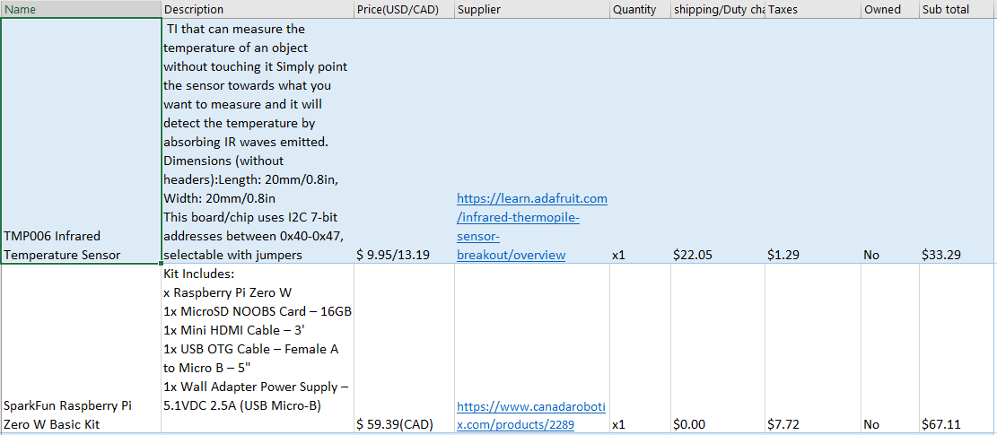
Budget
TMP006 – sensor
Raspberry pi zero w – microprocessor
Items owned: laptop,
electronic parts kit, SD card
Budget total: $100.40

Slide 5
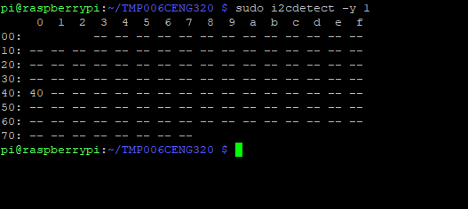
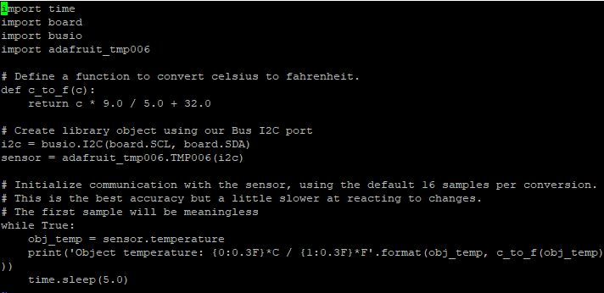
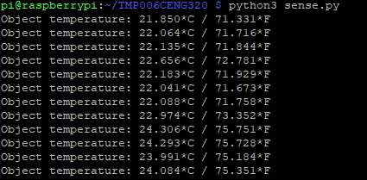
Readings
The sensor uses an i2c address
Can read ambient temperature
Language used is python

Slide 6
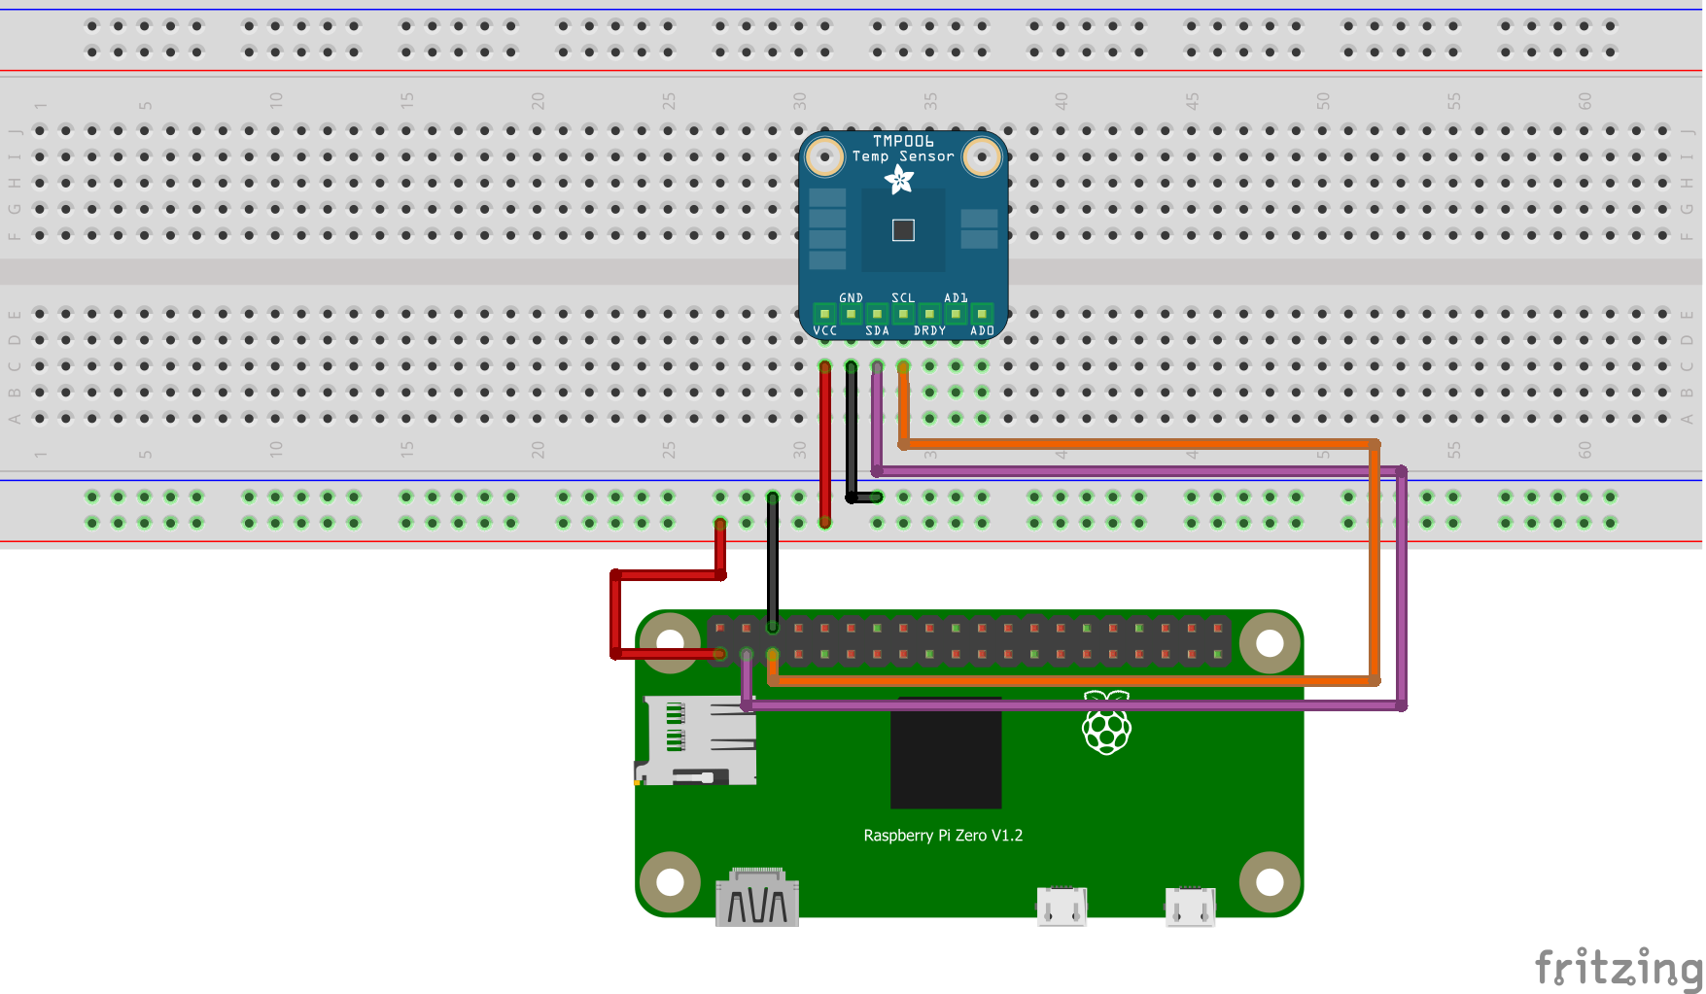
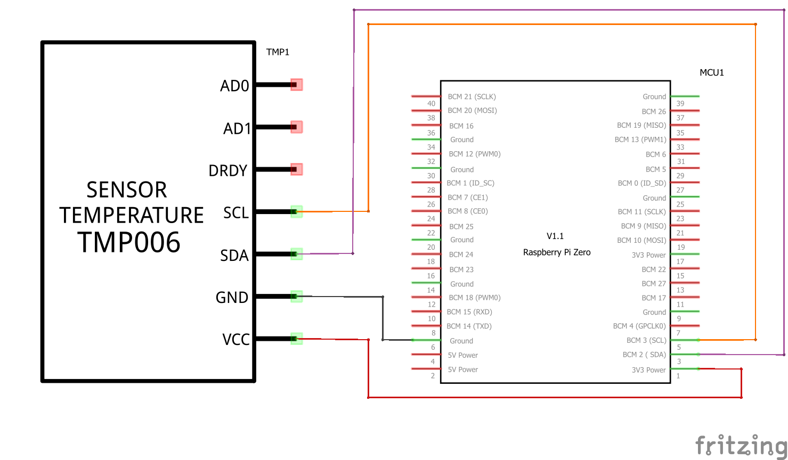
Course knowledge utilized from previous courses
CENG 200 Unix Scripting – Navigating consoles like putty
CENG 252 Embedded Systems – Creating and setting up firmware
CENG 216 Intro to Software Engineering – Creating Gantt charts
TECH 150 Electronic Devices and Circuits – Understanding of circuits and the testing of those circuits

Slide 7
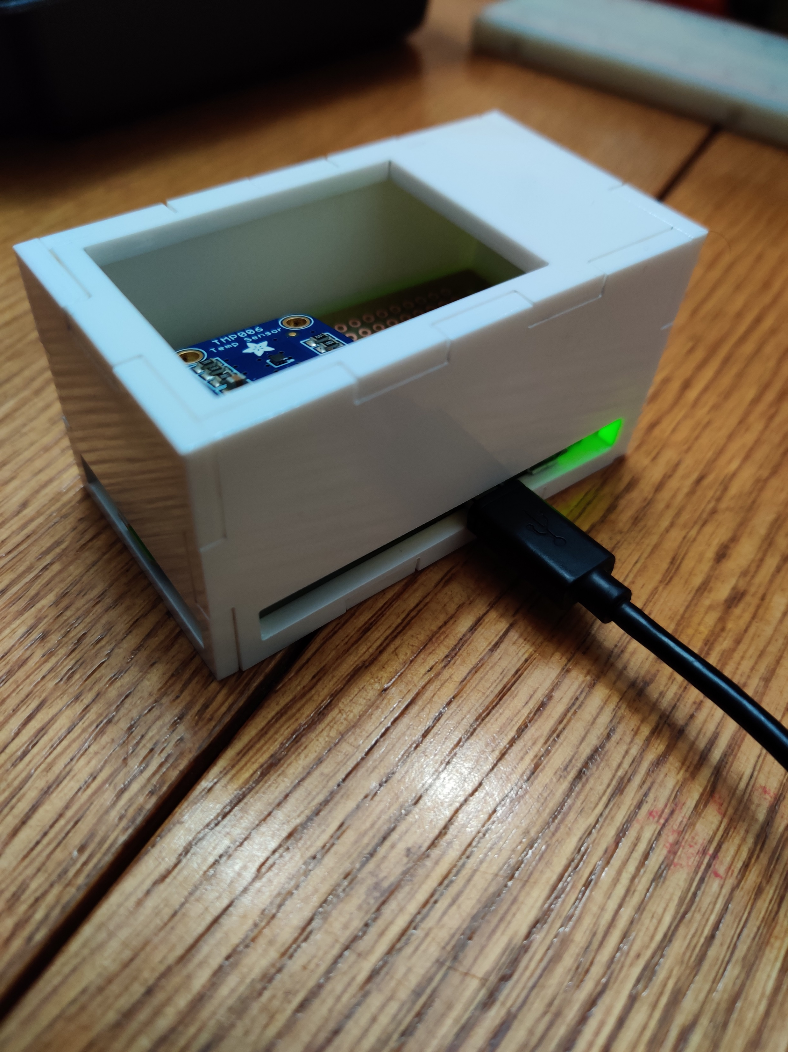
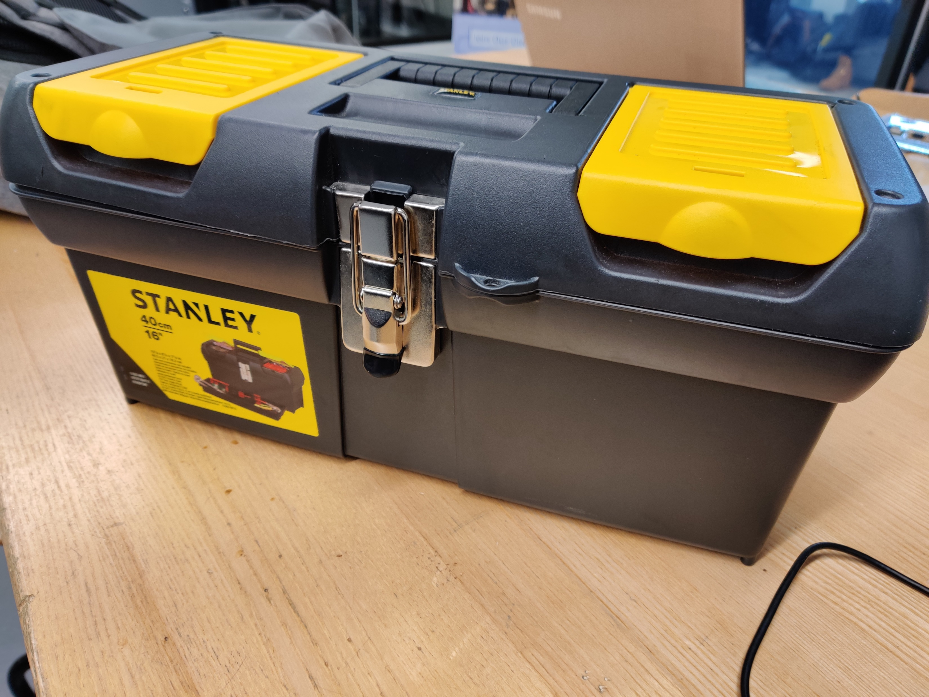
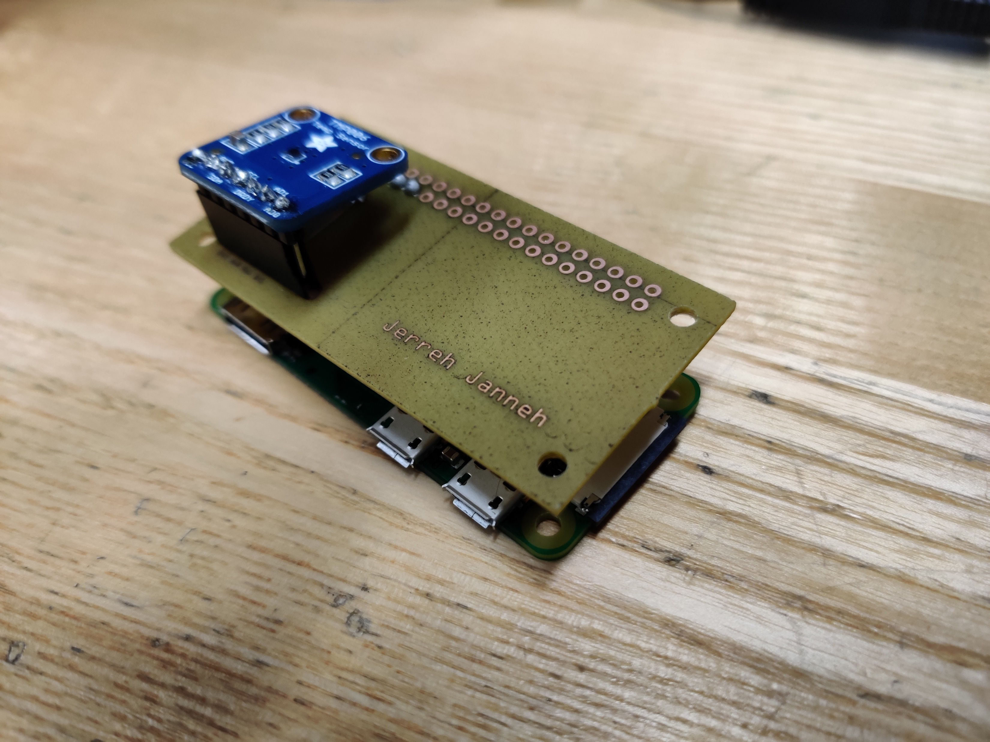
Thank you

